Slide 1

A Brief Introduction to SDN
V0.1
Notes:
What does it mean to say software-driven? For large network equipment vendors, software cost already accounts for 90% of R&D cost.

Slide 2
Outline
What is and why SDN?
Notes:
At a high level, abstraction is to hide issues that others do not want to or hard to do things.

Slide 3
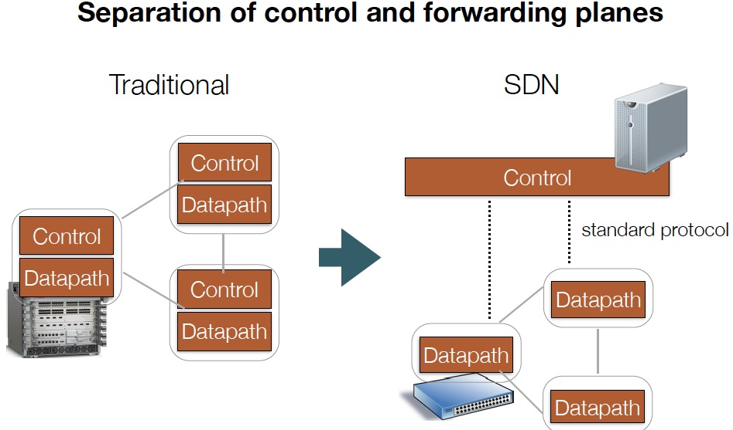
What is SDN?
Notes:
FLP, Arrow’s Impossibility Theorem. Failure of distributed computing.

Slide 4
Why SDN (Theory)?
Distributed computing is hard
FLP Impossibility Theorem
Arrow’s Impossibility Theorem
Achieved good design for only some simple tasks (e.g., leader election, shortest path), but we need to handle more complexity in many settings.

Slide 5
Why SDN (Architecture Theory)?
“Modularity based on abstraction is the way things get done.” -- Barbara Liskov
Major advance in many fields of computer science is based on simple, powerful abstractions.
A major lacking of networking is not enough good abstractions in network control.
Notes:
Hide details; Provide automatic optimization
Theory: Turing machine; systems: DB/relational algebra; OS/Virtual memory/thread; PL: low level language to higher level languages. Networking layer architecture is abstractions for data plane. Major advance is possible if we introduce the right abstractions in the network control plane.

Slide 6

Why SDN (Industry)?
“We are focusing on a market transition involving the move toward more programmable, flexible, and virtual networks… This transition is focused on moving from a hardware-centric approach for networking to a virtualized network environment that is designed to enable flexible, application-driven customization of network infrastructures. -- Cisco Annual Report (pp2), Nov. 2015
Notes:
“The cost to operate networks is too high and growing too fast and you can’t find enough people to manage these things anymore. It’s time for change.” -- Nick Lippis, ONUG /Fidelity, 2013
To appeal to companies looking for more highly customized systems, Cisco has also opened up its software to programmers in new ways, making it easier for clients to write their own apps for Cisco products.
http://www.bloomberg.com/news/articles/2015-11-05/cisco-s-new-ceo-embraces-the-cloud

Slide 7
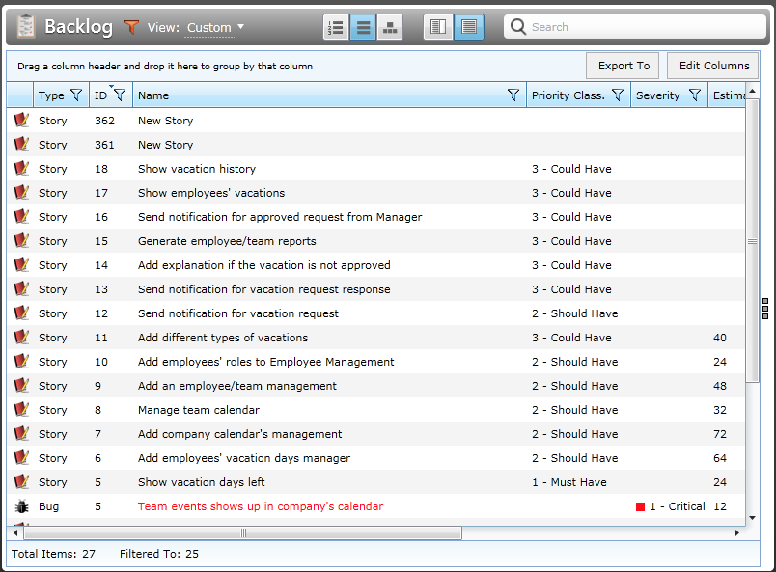
Why SDN (Industry)?
Network customization/feature requests can be a slow process.
Notes:
small (fewer than 1k hosts), medium (1k-10k hosts), large (10k-100k hosts), and
very large (more than 100k hosts) enterprise network

Slide 8
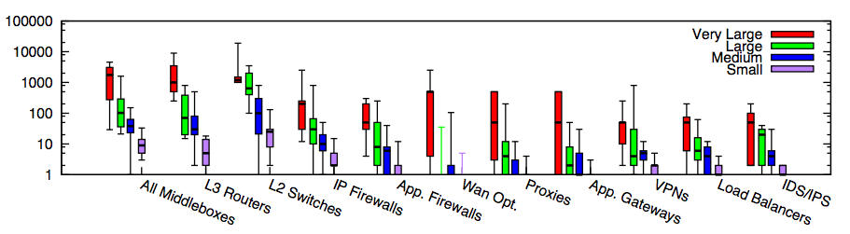
Why SDN or More Programmable Networks (Industry)?
Modern networks contain increasingly more diverse types of equipment
In traditional settings, each type/vendor runs in its own hardware box
Substantial flexibility if more programability
Small: <=1k hosts; Medium: 1k-10k; Large: 10k-100k; Very Large: >= 100k
Source: [Sherry, et. al SIGCOMM’12]
Notes:
为啥呢？因为total ownership cost少。1. 我server买了，3年合同以后可以自行切换。前三年load cisco的virtual router，后三年load juniper的virtual switch。再过三年load palo alto的virutal firewall 2. 设备performance更新，只需要换低层硬件，就可以扩展
Router, switch, firewall merge
Server + software, which include Router, Switch, FT
DC -> Cloud
ENT switch reducing; Cloud increasing
There are more virtual ports than physical ports, where the virtual ports are controlled by x86 software. Where software erodes hardware

Slide 9
Outline
What is and why SDN?
SDN now
Notes:
At a high level, abstraction is to hide issues that others do not want to or hard to do things.

Slide 10
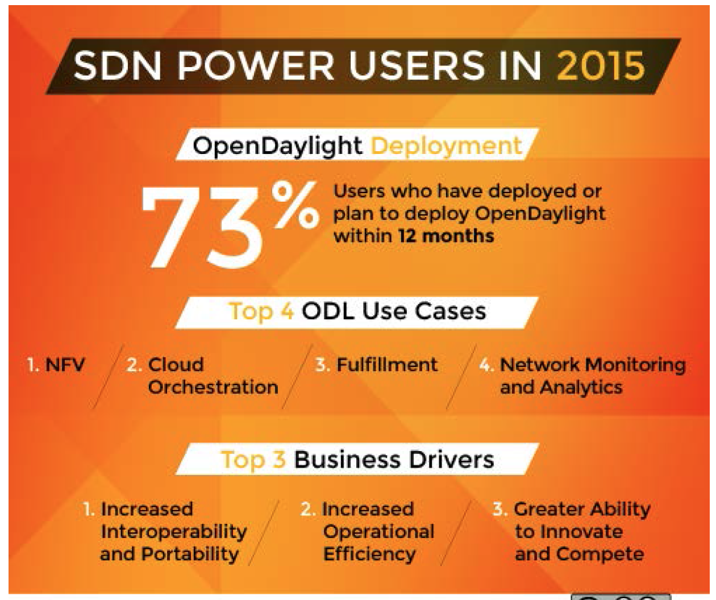
Results of a User Survey
128 Companies responded
31% Telcos/Service Providers
24% Research/Academia
20% Enterprises
10% Services/Consulting
9% Software/Hardware
6% Other
Source: Neela Jacques, July 2015.
Notes:
At a high level, abstraction is to hide issues that others do not want to or hard to do things.

Slide 11
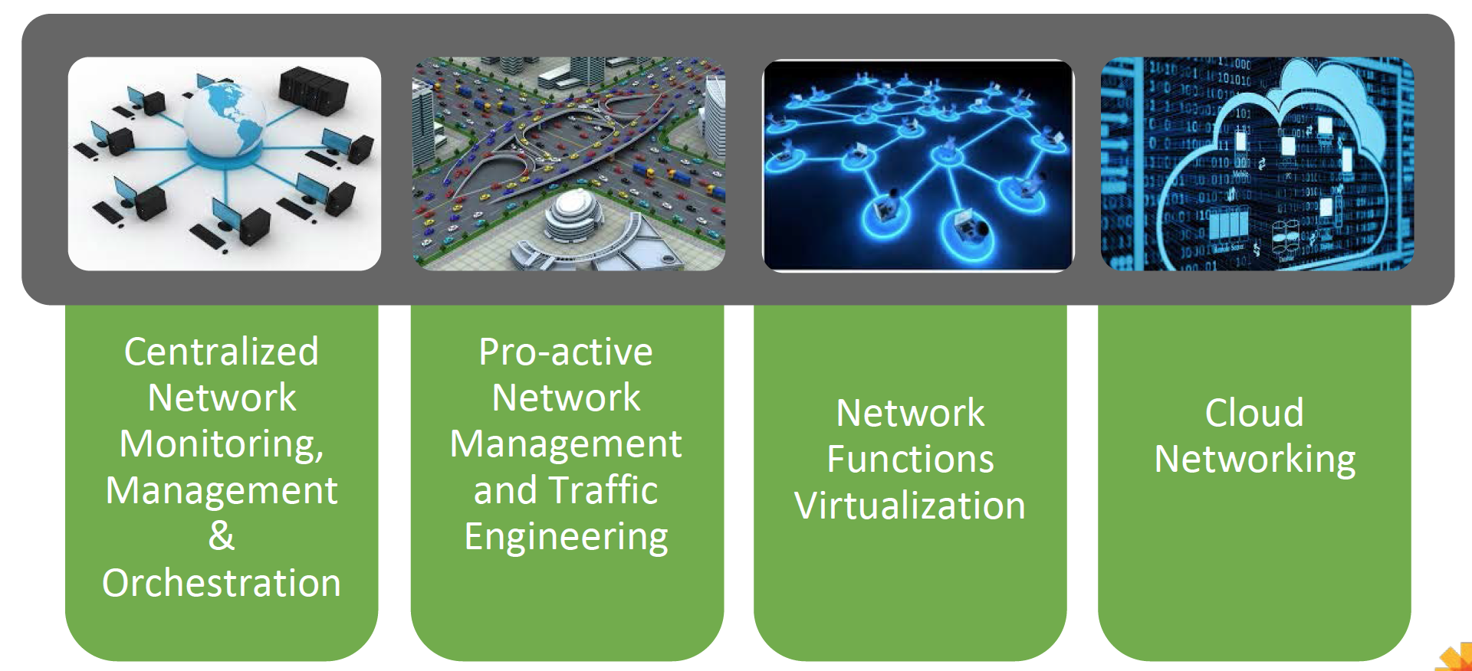
Some Main Use Cases of SDN
Source: Neela Jacques, July 2015.
Notes:
At a high level, abstraction is to hide issues that others do not want to or hard to do things.

Slide 12
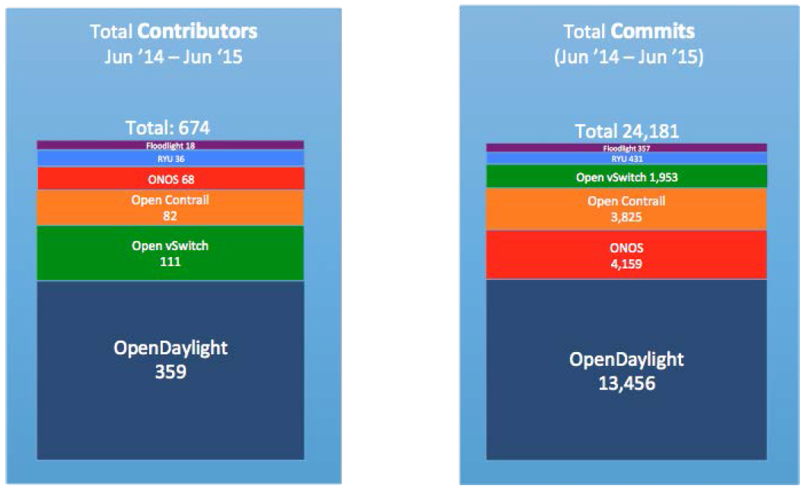
State of Current (Open Source) Players
Source: Neela Jacques, July 2015.

Slide 13
Outline
What is and why SDN?
SDN now
SDN technical components
Keep some key questions in mind while engage
Notes:
At a high level, abstraction is to hide issues that others do not want to or hard to do things.

Slide 14
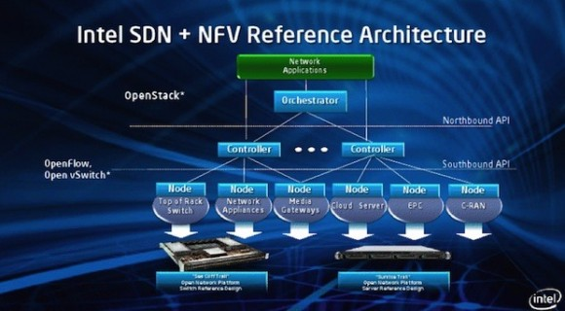
SDN Architecture (Intel)
Notes:
topology

Slide 15
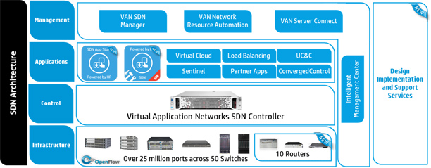
SDN Architecture (HP)
http://h17007.www1.hp.com/images/networking/solutions/technology/sdn/sdn-architecture.jpg
Notes:
topology

Slide 16
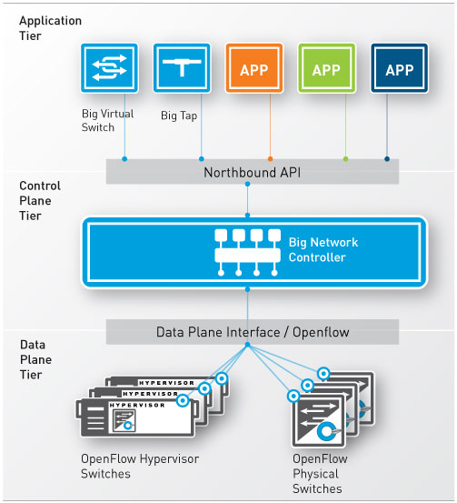
SDN Architecture (Big Switch)
http://www.bigswitch.jp/sites/default/files/_/bsn-sdn-architecture.jpg
Notes:
topology

Slide 17
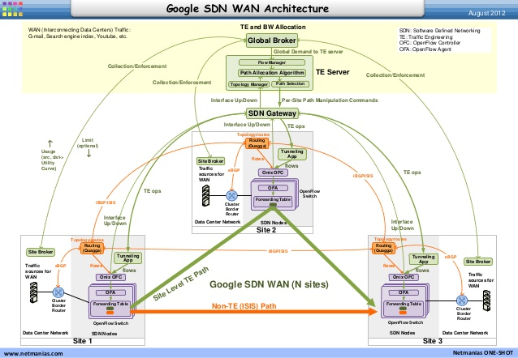
SDN Architecture (Google WAN)
Notes:
topology

Slide 18
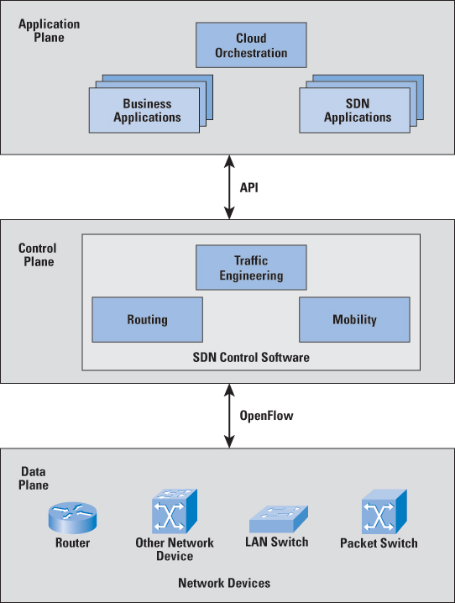
SDN Architecture (F5)
http://www.cisco.com/web/about/ac123/ac147/images/ipj/ipj_16-1/161_sdn_fig01_lg.jpg
Notes:
topology

Slide 19
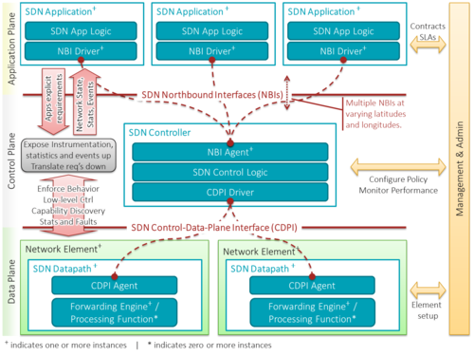
SDN Architecture (Wikipedia)
https://upload.wikimedia.org/wikipedia/commons/thumb/e/e6/SDN-architecture-overview-transparent.png/500px-SDN-architecture-overview-transparent.png
Notes:
topology

Slide 20
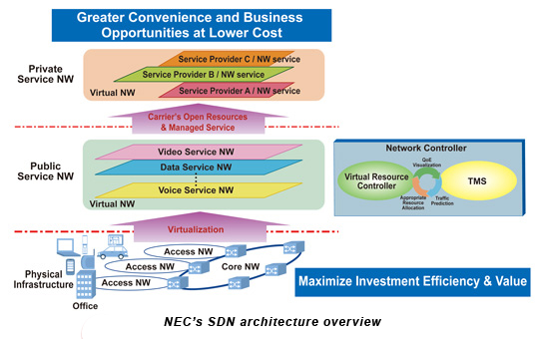
SDN Architecture (NEC)
http://www.nec.com/en/global/solutions/nsp/sdn/images/sdn_fig01.jpg
Notes:
topology

Slide 21
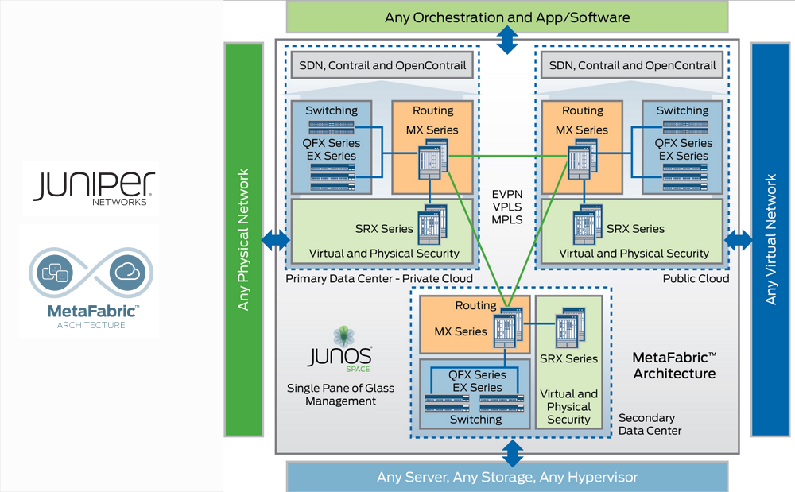
SDN Architecture (Juniper)
http://3.bp.blogspot.com/-iu3T6251FWU/UnBzpb4pZuI/AAAAAAAAsiQ/ryAVMVyA78A/s1600/juniper-metafabric.png
Notes:
topology

Slide 22
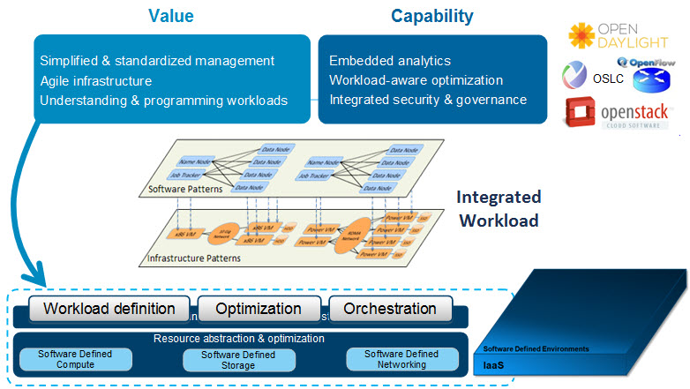
SDN Architecture (IBM)
http://www.ibm.com/developerworks/cloud/library/cl-open-architecture/figure2.jpg
Notes:
topology

Slide 23
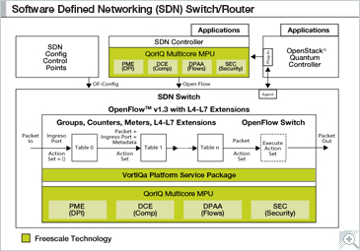
SDN Architecture (F5)
http://cache.freescale.com/files/graphic/block_diagram/APLSDN_BDTN.jpg
Notes:
topology

Slide 24
SDN Architecture (F5)
Notes:
topology

Slide 25
SDN Architecture (F5)
Notes:
topology

Slide 26
SDN Architecture (F5)
Notes:
topology

Slide 27
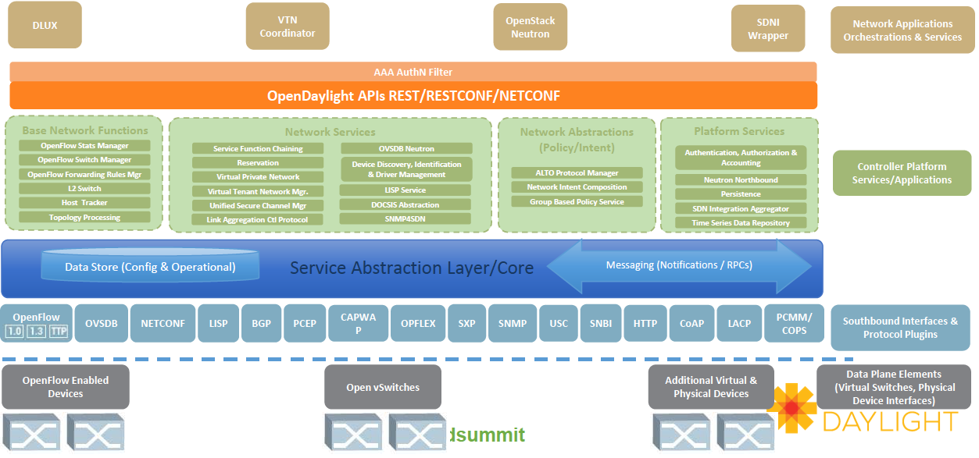
OpenDaylight Software Architecture
Does this architecture have enough as a base of network softwarization?
Source: Neela Jacques, July 2015.
Notes:
http://www.bigdatalandscape.com/

Slide 28
OpenDaylight Architecture
Network Devices
Applications
Network Applications Orchestration & Services
Network Devices
Applications
Network Devices
Applications
Controller
NETCONF SERVER
Protocol Plugin
...
Protocol Plugin
App/Service Plugin
...
App/Service Plugin
RESTCONF
Plugins & Applications
Config Subsystem
Model-Driven SAL (MD-SAL)
Controller Platform
Messaging
Data Store
Clustering
Remote Controller Instance
Remote Controller Instance
Source: Ed Warnicke, July 27, 2015.
28

Slide 29
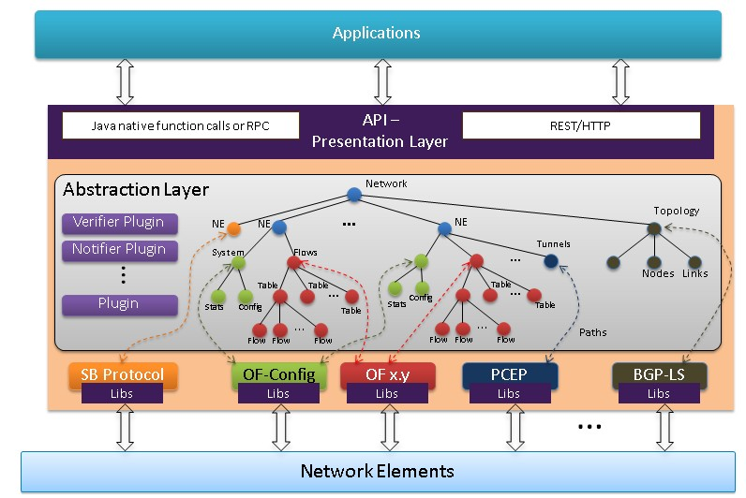
OpenDaylight Architecture
https://wiki.opendaylight.org/view/OpenDaylight_Controller:Architectural_Framework

Slide 30
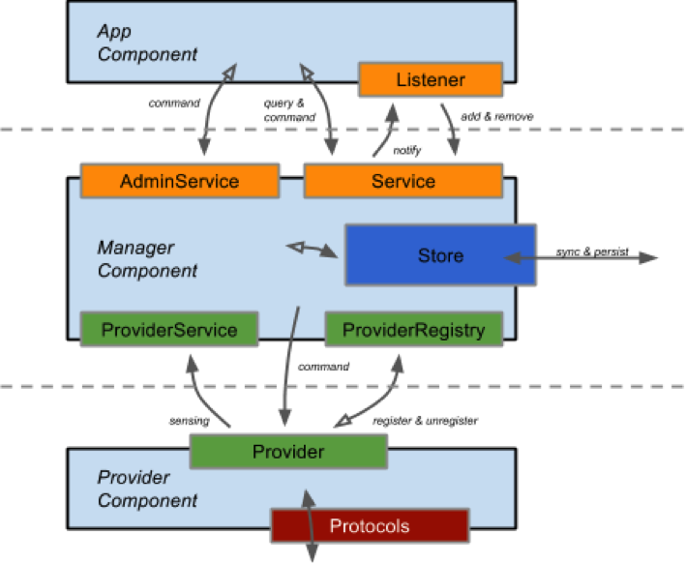
ONOS Architecture
https://wiki.onosproject.org/display/ONOS/System+Components
Notes:
http://api.onosproject.org/1.1.0/org/onosproject/store/Store.html DeviceStore, HostStore, LinkStore, TopologyStore collect info from below
FlowRuleStore supports forwarding abstractions
IntentStore

Slide 31
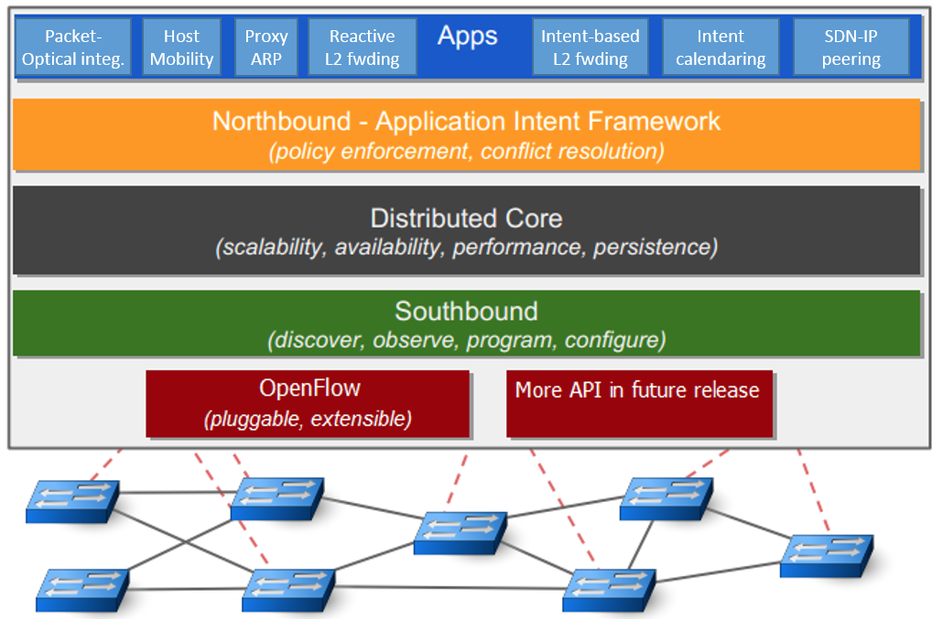
ONOS Architecture
Notes:
http://api.onosproject.org/1.1.0/org/onosproject/store/Store.html DeviceStore, HostStore, LinkStore, TopologyStore collect info from below
FlowRuleStore supports forwarding abstractions
IntentStore

Slide 32
Key Areas for Abstraction
Three key areas for abstractions [Shenker’11]
Distribution, configuration, forwarding
Notes:
topology

Slide 33
What’s New and Important in SDN
- Network apps, e.g., xxx
- Network programming languages, e.g., Frenetic, Maple, …
- Network OS, e.g., Floodlight, ONOS, OpenDaylight, NOX, Ryu, …)
SNMP
Forces
NetConf RestConf
OpenFlow
OpenFlow1.x OFDPA P4 POP
…
Notes:
OpenFlow receives the most attention. However, Doug Commer from Purdue talk at ONUG’14: the school invented OpenFlow teaches magic…

Slide 34

Key Datapath Question
What should be the data path of network devices?
Flow table
VM/Container

Slide 35
Key Configuration Question
Map<MAC, Location> hostTable; List<ACLItem> acls;
Route f(Packet p) {
hostTable.put(p.ethSrc(), p.ingressPort());
if ( !permit(p, acls) ) return drop;
Location src = p.ingressPort();
Location dst = hostTable.get( p.ethDst() );
Route path = myRoutingAlg(topology(), src, dst);
return path;
}
Declare states
External process may change the state
Access pkt attributes
External process may change the state
Access state
Access state
Access state
Complex computation
Data path can causes state update

